Slide 2
Mind
Help
Your One Stop Point For The Betterment Of Mind

Slide 3
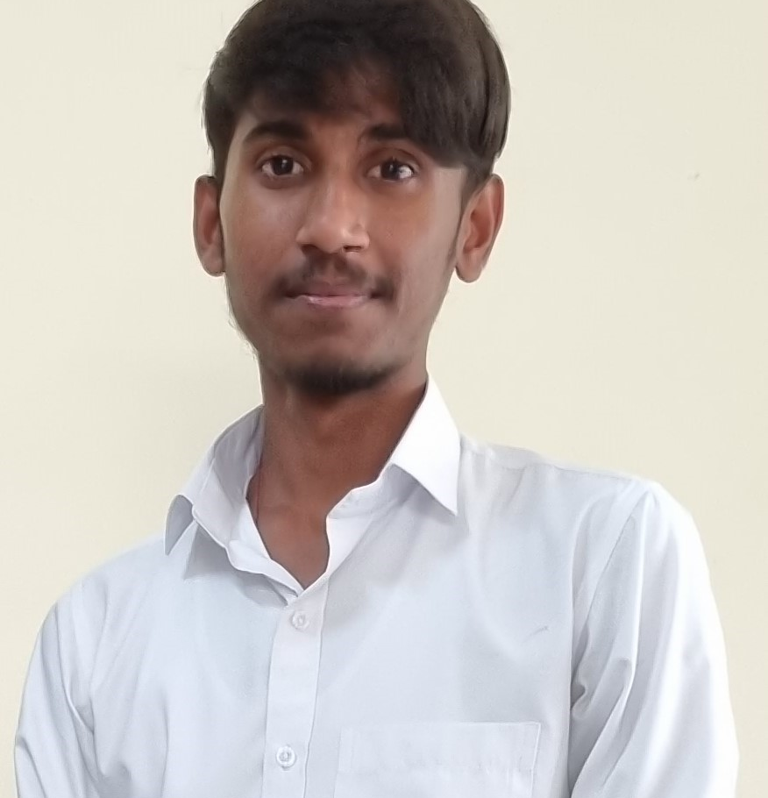
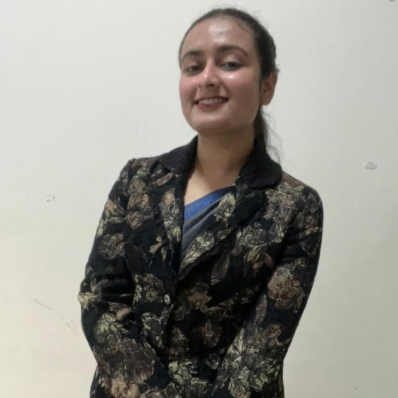
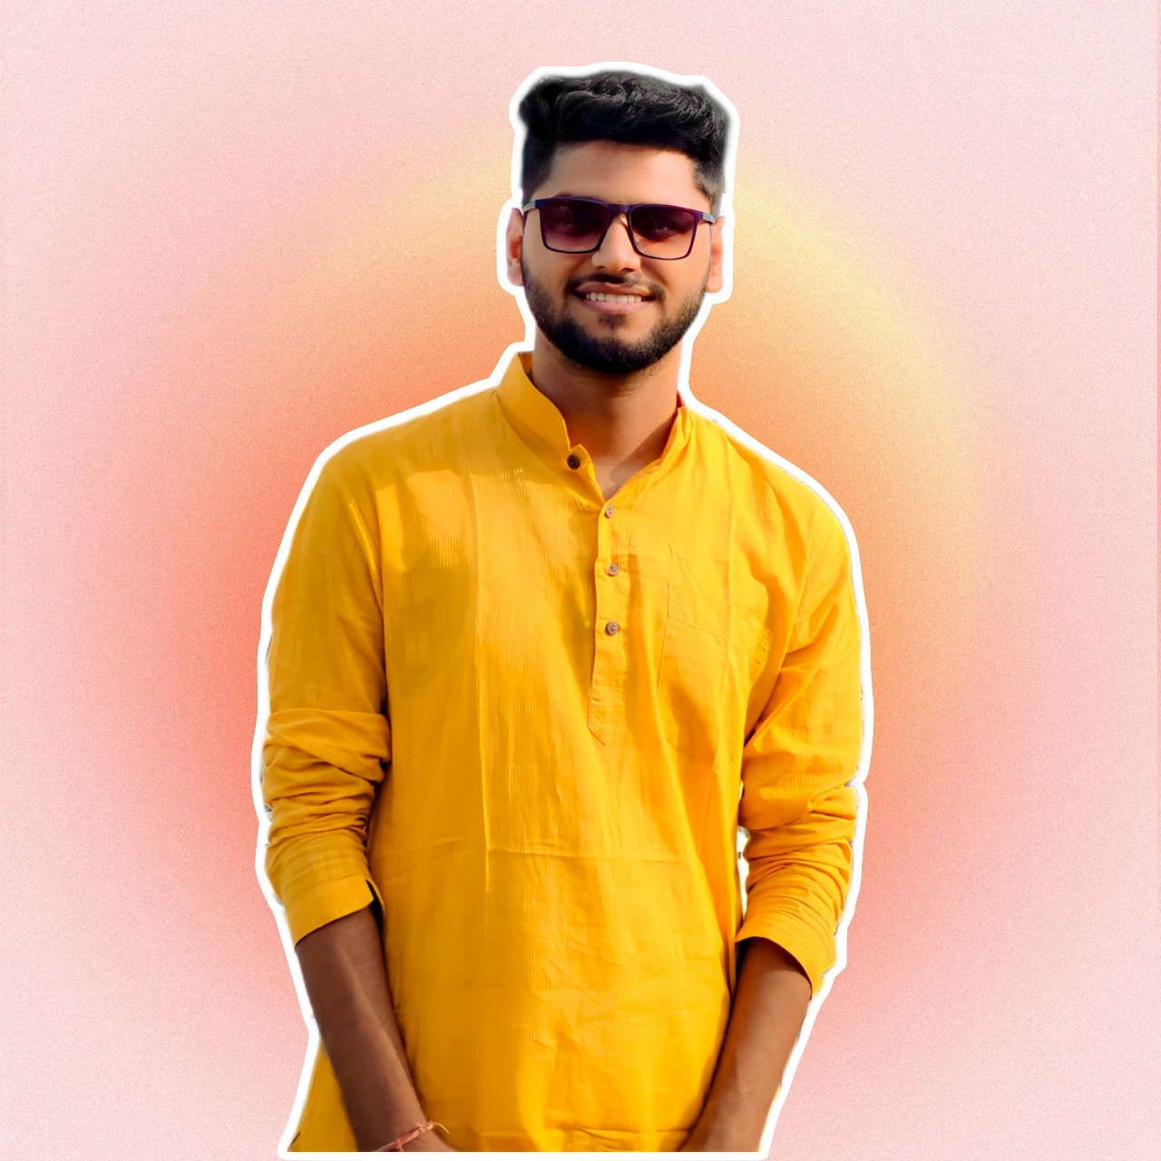

Our Team(Tech-Forge)
Utkarsh
Prakhar
Palak Jasrotia
Rishi Raj Gautam
M Dhruv Singha

Slide 4
Our Team(Tech-Forge)
Rishi Raj Gautam
Palak Jasrotia
M Dhruv Singha
Utkarsh
Prakhar

Slide 5

5 Apps

Slide 6
5 Apps
Calm
Headspace
Sanvello
Happify
Bearable

Slide 7
Table of contents
Problems
Implemented Plan
1
4
Targeted Audience
2
5
Utility of our Product
Design
3
6
Future Scope

Slide 8
Table of contents
1
Problems
4
Business Model
2
Targeted Audience
5
Utility of our Product
3
Design
6
Future Scope

Slide 9

1
Problems

Slide 10
1
Problems

Slide 11
Limited Geographic Origin of Top Mental Health Apps
Fragmented Features and High Cost of Mental Health Apps
Currency Conversion and Lack of Cancellation Policy
Outdated Reviews and Concerns about Content Updates
Concerns about the questionnaire feature in Mental Health Apps

Slide 12

2
Targeted Audience

Slide 13
2
Targeted Audience

Slide 14
Caregivers or Loved Ones Seeking Resources
Individuals Seeking Mental Health Support
People Looking for Convenient Ways to Practice Self-care
Individuals Experiencing Stress, Anxiety, Depression
Interested in Exploring Therapy/Counseling Digitally
Professionals in Mental Health Field

Slide 15
Individuals Seeking Mental Health Support
People Looking for Convenient Ways to Practice Self-care
Caregivers or Loved Ones Seeking Resources
Individuals Experiencing Stress, Anxiety, Depression
Interested in Exploring Therapy/Counseling Digitally
Professionals in Mental Health Field

Slide 16

3
Design

Slide 17
3
Design

Slide 18
Backend
Managing user authentication and authorization
Secure profile and blog management
Facilitating secure communication channels
Ensuring data encryption and privacy
Security auditing and logging
Backup and disaster recovery measures
Continuous security updates and patching

Slide 19
Frontend
AI Mental Health Blog:
Collaborative post from multiple blogs.
Explores advancements and applications of AI in mental health.
Range of Popular Blogs:
Display most popular blogs on mental health.
Curated selection to provide valuable insights and resources.

Slide 20
Frontend
Consultation Section:
Suggests doctors based on patient ratings and availability.
Facilitates easy booking of consultations for users.
Continuous Chatbot Option:
Chatbot appears continuously on the screen.
Offers immediate support and guidance to users.

Slide 21
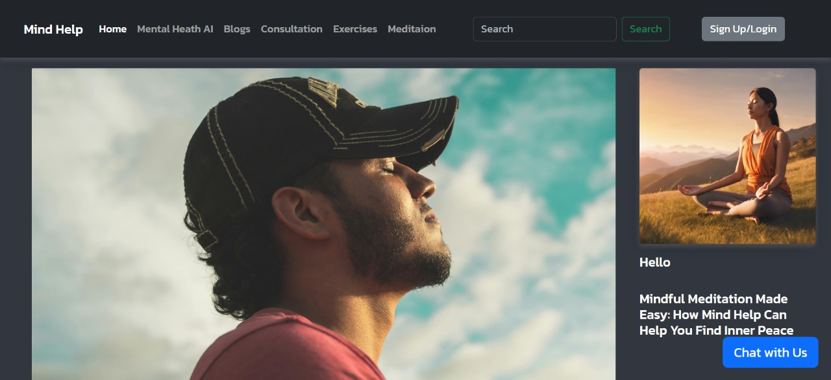
Screenshot of Product

Slide 22
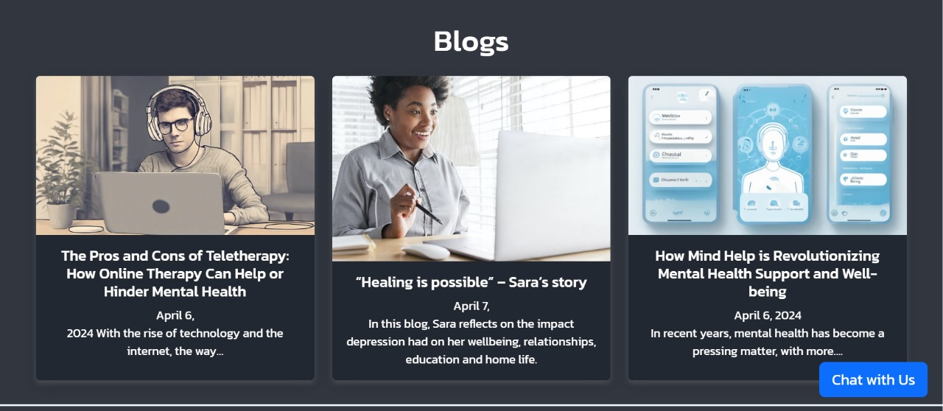
Screenshot of Product

Slide 23

4
Business Model

Slide 24
Chatbot & AI Integration:
Free Problem Resolution:
Revenue through Sponsorships:
Video Conference Calling:
Authentic Blog Content:
Ad-Free Environment:

Slide 25

5
Utility OF Our Product

Slide 26
5
Utility OF Our Product

Slide 27
Convenient access to comprehensive mental health support
Fosters community engagement while ensuring user privacy and security
Allows users to track progress and access educational resources
Empowers individuals to improve their mental well-being on their own terms

Slide 28

6
Future Scope

Slide 29
6
Future Scope

Slide 30
Integrated Features and Pricing Strategy
Localized Support and Policies
Continuous Content Updates and User Engagement
Professional Endorsement and Collaboration
Targeted Marketing and Outreach
Meditation and exercise content

Slide 31
Thank
You

Slide 32
Thank
You

